Slide 1
Parent Handbook
Manta Ray Swim Program

Slide 2

Swim Team Practice and Meet Schedule
To find the current practice and swim meet schedule you can go to the Manta Ray Team Unify website:
https://www.teamunify.com/Home.jsp?team=ymca-6767
Current practice schedules are under the “About the Team” tab.

Slide 3
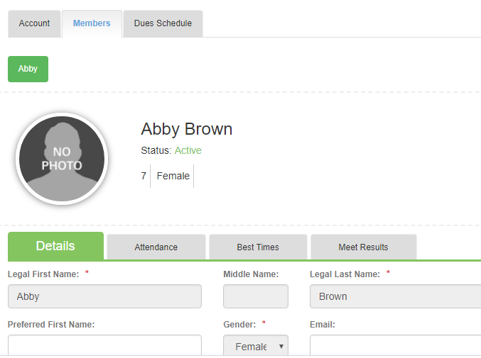
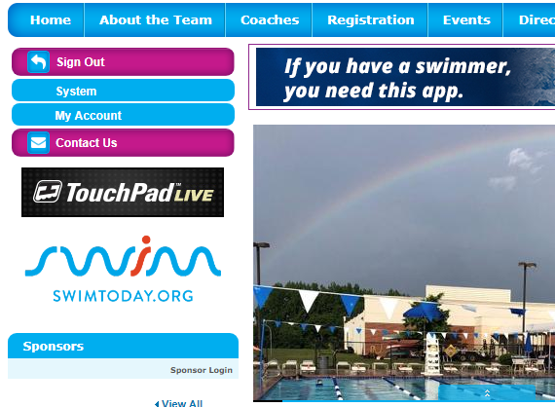
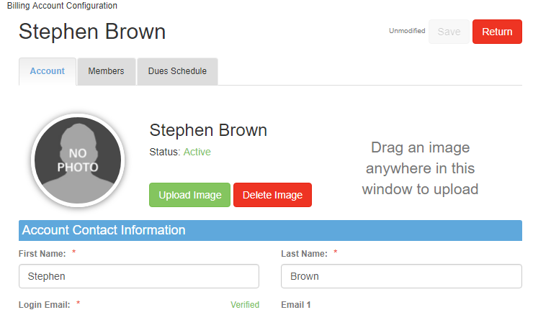
Update your account on Team Unify
Parents and swimmers have a Team Unify Account.
Home Page
Please update your contact information on your Account page and include any emergency or allergy information on your Member page.
Account Page
Member Page

Slide 4
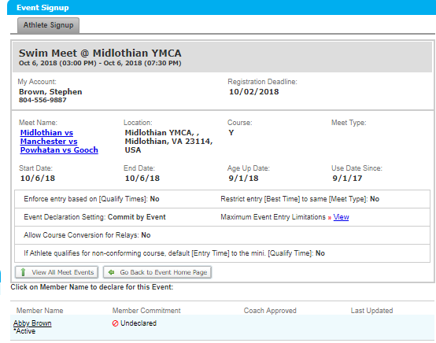
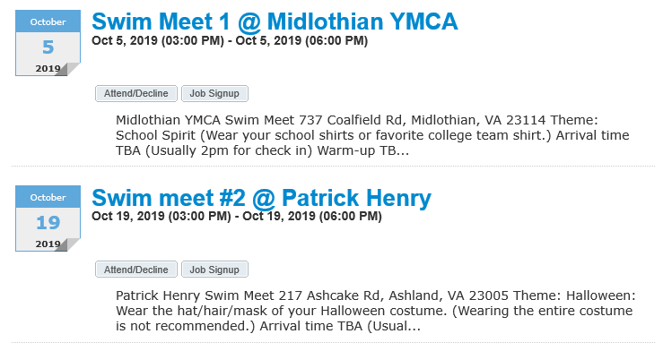
Signing up for a swim meet
Go to Events Page and click on Attend/Decline

Slide 5
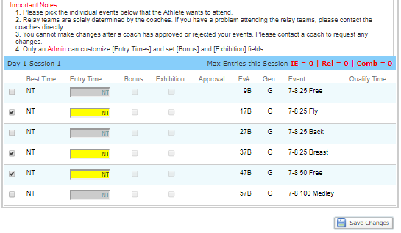
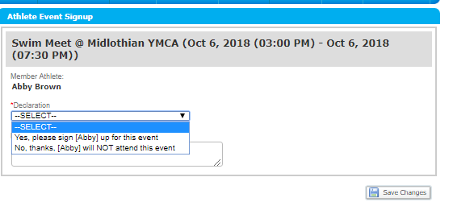
Declaring Yes/No and picking events
You may suggest events for coaches, but you do not have to pick events.
Coaches will make final decision on events and you are able to see all changes.
Relays are decided by coaches and will show up on the Team Unify Page. Relays are not guarenteed
Choose Yes/No
Don’t forget to SAVE!!!!
Even after the deadline, you may return to this page to see if the coaches have left notes or made changes.

Slide 6
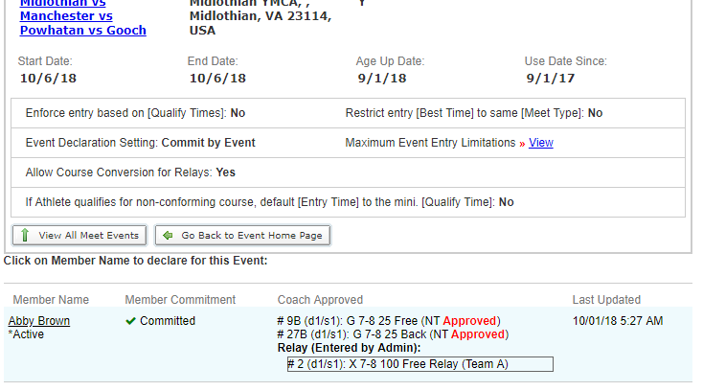
Checking events for the upcoming meet
Once a meet deadline has passed, you can continue to review your child’s events by logging back into the commitment page. You will not be able to make any changes. If you see an error, contact coach Helen. Most errors are fixable until the day of the meet.
When a coach has finalized events, “Approved” will appear on the event page.
Relays will appear here. Remember that relays may change the day of the meet.

Slide 7
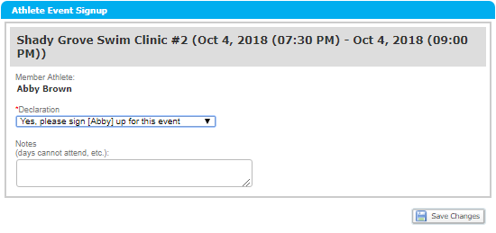
Other events
Signing up
Sometimes Yes or No are your only options when declaring for an event.
If we need parent help, a Job Signup tab will appear with the event.
Don’t forget to SAVE!!!!

Slide 8
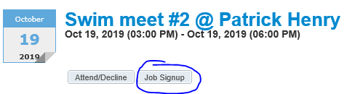
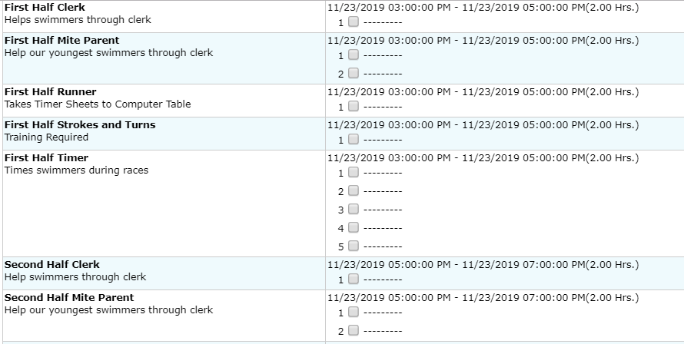
Job Sign Up
Clicking on JobSignup will take you to a page that lists all the possible volunteer positions needed. Most do not require training.
Choose a volunteer position. We appreciate your help!

Slide 9
Practice expectation for swimmers
Swimmer Responsibilities
Attend as many practices as possible
Be swim ready 5 minutes before practice starts
Stay positive
Ask questions when you do not understand
Pay attention to the coaching staff
Respect coaches and fellow swimmers at all times.
Encourage and support team members
Be prepared for practice
Goggles
Cap
Towels
Water
Sun screen
Good Atttude

Slide 10
What’s a Ladder and other odd things the Coaches say
You might find yourself sitting around the pool deck watching practice and wonder what stroke your child is supposed to be swimming as they oddly move down the pool lane. Coaches have many tactics they use to help the swimmers learn to “feel” how they move through the water.
A complete list of on-deck coaching terms:
https://www.teamunify.com/Newsletter.jsp?_tabid_=124382&team=ymca-6767

Slide 11
How to navigate a swim meet
Arrive by the designated team check-in time.
Swimmers should already prepared for warm-up upon arrival
Check in with Coach
Parents visit the volunteer table and pick up your volunteer badge. (meets are run by parent volunteers)
Enjoy watching the races.
The article on our website “Swim Meet Survival Guide” will provide you tips to make each swim meet a fun experience. (Documents Tab)

Slide 12
What does that DQ mean next to my child’s meet results?
Sometimes the Strokes and Turns judge disqualifies, DQ, a swimmer. USA swimming rules apply at all the GRAL and YMCA league meets. All parents are encouraged to consider training to be a Strokes and Turns Judge. It is a great way to share in their child’s swim team experience.
Here is a link to the USA officials training videos. Review them and observe the swim meets. Becoming a judge is easier than you think.
https://www.usaswimming.org/officials/officials-training-videos

Slide 13
Volunteer Positions
Swim league meets are run by parents. Volunteer positions are separated into two categories:
Positions required training
Referee
Strokes and Turns
Clerk (Training required summer only)
Starter
Head Table Worker (Summer onlhy)
Positions not requiring training
Head Timer
Timer
Computer Table Worker
Award Ribbons
Mite Parent

Slide 14
Pool rules and Etiquette
All YMCA pools rules apply during swim team practice
Swim practice rules and curtesies
Parents
Allow coaches to work with the swimmers uniterrupted during practice and swim meet
Communicate with coaches outside of practice times in person/phone/email
Support your child by being thier biggest cheer leader
If you have concerns express them to the parent representative
Swimmers
No diving unless instructed by coach
Misbehavior on deck or in locker rooms will not be tolerated
Respect coaches and teammates at all times
Ask questions of coaches and teammates if you are unclear on instructions

Slide 15
How to get the most out of the season
Arrive on time to practice. We understand things happen and know you will do your best! Swimmers arriving late should speak with the lane coach before entering the pool.
Check out the information posted on the Team Unify Website. An educated swimmer is a focused swimmer
Add another practice to your week. It can be any cardio or strength workout. We have designed exercises to the specific needs of swimmers. Don’t hesitate to ask for suggestions.
Set goals and keep track of your progress.

Slide 16
Parent-Swimmer-Coach rules and responsibilities
A great swim program relies on cooperation between parents, coaches, and swimmers.
Swimmer/Parent/Coach responsibility and expectations can be found on our website:
https://www.teamunify.com/Newsletter.jsp?_tabid_=124382&team=ymca-6767

Slide 17

Goochland Manta Rays
Thank you for reviewing our parent handbook.
If you have any questions:
Jalen Hargrove (Aquatics Director) hargrovej@ymcarichmond.org
Krista Evans (Board Member) Evansk@ymcarichmond.org
Have a great season!

